Slide 1
Topic 4 Issues related to accounting for assets
Reference:
Deegan, C, 2010, Australian Financial Accounting, Chapter 4

Slide 2
Introduction
Before we consider the AASB Framework definition of an asset let us consider whether the following would normally be considered ‘assets’?
  University buildings
  A lecturer’s intellectual capacity
  Trees around the campus
  Costs of establishing a state-of-the-art on-line staff-student communication system
  Clean air
  Now let us consider the AASB framework definition …

Slide 3
AASB Framework definition:
“An asset is a resource controlled by the entity as a result of past events and from which future economic benefits are expected to flow to the entity” (Framework for the Preparation and Presentation of financial Statements, Accounting Handbook)
Let us consider the characteristics of an asset under this definition

Slide 4
Definitional characteristics
‘Future economic benefit’
‘control’ of resource
‘Past event’
Let us look further at these characteristics …

Slide 5
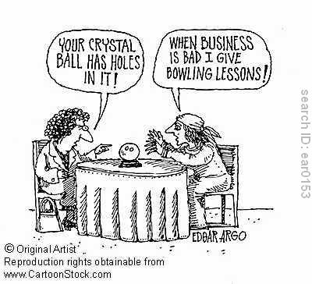
1. Future economic benefit
‘the scarce capacity to provide benefits to the entities that use them’ (para. Aus49.1)
Normally ‘the potential to contribute, directly or indirectly, to the flow of cash and cash equivalents to the entity’ (para.53).
How do resources contribute to cash flow?
  production of goods and services which are then sold
  exchange/sale
  the capacity to reduce cash outflows
  purchasing power

Slide 6
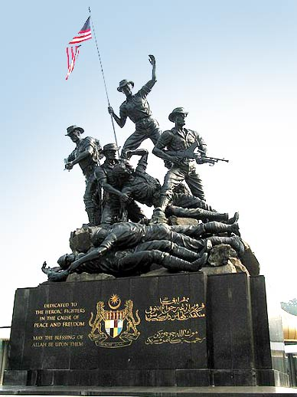
Future economic benefit cont.
Not-for-profit entities: benefits not restricted to financial benefits!
  paras. Aus54.1 and 2 suggest that while the resources of not-for-profit entities, for example national parks, roads, monuments, may not result in net cash inflows they do benefit the entities by enabling them to meet their objectives and therefore should be recorded as assets!
Let us focus first on profit pursuing entities and try to apply this criterion …

Slide 7
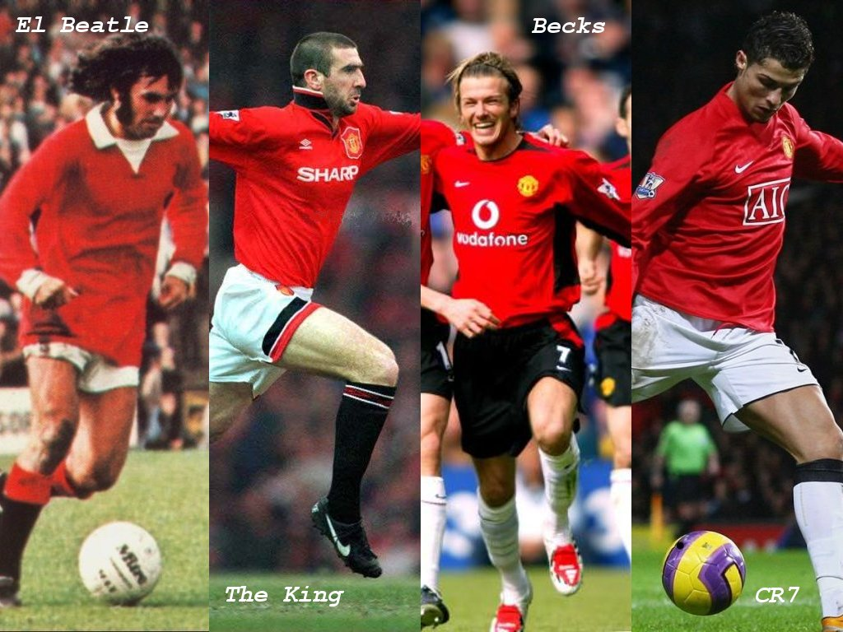
Future economic benefit?
Nike signed a sponsorship contract with Manchester United (English soccer team) for $313 million
A development company is planning to build a new supermarket. The cost of clearing the site for the new building is $100,000
Is there an expected future economic benefit (FEB)? If so what is it? Relate to the description of FEB

Slide 8
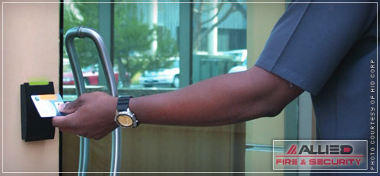
2. Control
Not defined!
In SAC4 (replaced by AASB framework) control defined as the capacity of the entity to benefit from the asset in pursuit of its objectives and to deny or regulate the access of others to that benefit
In AASB 138 ‘Intangible Assets’ ‘control’ is defined as where the entity has the power to obtain the FEB flowing from the resource and can restrict access of others to those benefits

Slide 9
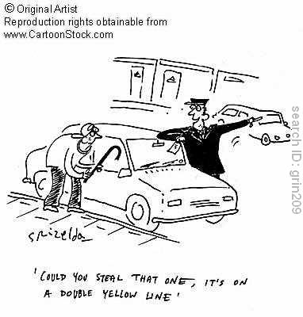
Control continued
Normally indicated by a legal right but secrecy may also allow control
What event would/could give rise to the ability to deny access of others to the benefit from something eg. A motor vehicle?
Control must be a result of a ‘past event’ …

Slide 10
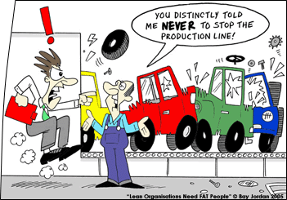
3. Past event
Not defined
Examples: purchase, production, discovery
What event/s may lead to the recognition of accounts receivable/debtor (ie. control of future benefit)?
    Order is received?
    Work on ordered goods has begun?
    Goods completed and ready for delivery?
    Goods are delivered?
    Cash is received?

Slide 11

Past event (which results in ‘control’)?
Nike signed a sponsorship contract with Manchester United (English soccer team) for $313 million
A pharmaceutical company spent $250,000 on research and development. Research indicates commercial viability. Formula not patented
Geelong Football Club players?

Slide 12
Items may meet the definition of an ‘asset’, however, they must also meet the “recognition criteria” to be recorded in the accounts …

Slide 13
Framework recognition criteria
‘assets’ should be recorded in the accounts when:
  future economic benefits are ‘probable’ [not defined - more likely than less likely!]
  Cost or other value can be ‘measured reliably’ [not defined!] (AASB framework, para. 83)
Let us try to apply these criteria …

Slide 14
Recognition: Scenario 1
One of your friends has decided to open a restaurant and has asked your advice on how she should account for a cooking pot which she has invented and plans to use in the restaurant. She believes the pot will revolutionise Indian cooking. She is considering patenting the design. She is unsure how much she has spent on the cooking pot, although she estimates she has spent about $2,500 and the cost of patenting the pot will be around $2,000. She believes that the pot is worth at least $40,000 in future revenue.
Required: Discuss whether, and if so how, your friend should recognise the pot

Slide 15
Recognition problems
SAC4 recognition criteria are not defined and their application is subjective, arbitrary (eg. 51% probability recognised but 49% not recognised regardless of significance), and difficult to apply in practice. This allows considerable opportunity for manipulation of the accounting numbers
Let us now discuss the measurement of assets in more detail …

Slide 16
Asset measurement
Framework descriptive - gives no guidance on asset measurement.
Definition identifies important attribute as ‘future economic benefit’
What is the appropriate money measure/measurement of future economic benefit? Hint: what is the future benefit from inventory? How can we measure that in today’s terms?

Slide 17
Asset measurement: ’reliability’
Uncertainty of ‘future economic benefit’
Multiple future benefits eg. from sale or from use. Which?
Where assets utilised in groups benefits cannot be disentangled/isolated eg. a factory used to produce clothes
These issues are unresolved. As a consequence …

Slide 18
Many different measurements used in practice:
Lower of cost and net realisable value – inventory
Cost eg. intangibles with indefinite useful life
Depreciated cost (or revalued amount eg. selling price or replacement cost) – property plant and equipment
Discounted present value of future cash flows – ‘finance leases’
‘Fair’/exchange value - financial instruments, biological assets, superannuation fund and insurance company assets; identifiable intangible assets if an active market
Recoverable amount (higher of selling price and value in use). Depreciable assets must written down to recoverable amount if lower than carrying amount
This results in additivity problems and possibly misleading financial reports, for example …

Slide 19
Reliability of measurement cont.
The balance sheet? Is it a statement of
  past financial position?
  present financial position?
  future financial position?
  all of the above?
Focus on the future ignores user needs for reliable information about the present

Slide 20
Asset measurement: relevance
What is the relevance of the measurement of ‘future economic benefits’
  To an investor?
  To a potential lender?

Slide 21
Analysis of definition
Ignores users’ needs for reliable information about the present.
No clear guideline as to what is or is not an asset eg. Important concepts not defined or clarified sufficiently eg. control; uncertainty as to what or whether benefits have been used or remain eg. intangibles, non-current assets, development costs
No reliable basis for determining future benefits
Definition may change given recognition by FASB and IASB of shortcomings

Slide 22
Alternative asset definitions
Legal notion: Property (rights of ownership) which are available to pay debts (accounting notion up to 1880s)
Separably exchangeable property
Cash, claims to cash and items that can be sold separately for cash
In the next lecture we will discuss some of the accounting issues surrounding government assets and intangible assets but first …

Slide 23
Assets and the theory of accounting policy choice
The theory would suggest that where schemes/contracts exist that reward managers after a pre-specified level of profit or sales has been reached managers may adopt accounting methods consistent with that bonus, for example:
  where profits were not expected to reach the level required managers may adopt income increasing practices eg. Capitalise costs (record as assets) which would normally be recorded as operating expenses, OR
  Adopt strategies that further reduced income (‘taking a bath’) eg. by accelerating the writing off of assets, but would lead to higher income in future periods (as occurred in the case of Sunbeam)

